Slide 1
AI CHATBOT USING CHATGPT
SUBMITTED BY
VINOTH KUMAR .E
810021114095
(AI)

Slide 2
ACKNOWLEDGEMENT
We would like to take this opportunity to express our deep sense of gratitude to all individuals who helped us directly or indirectly during this thesis work.
Firstly, we would like to thank my supervisor Dr.V.C.SATHISH GANDHI, M.E, MBA, PH.D. for being a great mentor and the best adviser I could ever have. His advice, encouragement and the critics are a source of innovative ideas, inspiration and causes behind the successful completion of this project. The confidence shown in me by him was the biggest source of inspiration for me. It has been a privilege working with him for the last one year. He always helped me during my project and many other aspects related to the program. His talks and lessons not only help in project work and other activities of the program but also make me a good and responsible professional.

Slide 3
ABSTRACT OF THE PROJECT

Slide 4
This project explores the design, development, and implementation of an AI chatbot powered by OpenAI's ChatGPT. The chatbot leverages natural language processing (NLP) and machine learning capabilities to provide human-like interactions across a range of conversational scenarios. Utilizing the advanced language generation model of ChatGPT, the chatbot can understand, generate, and respond to complex human language in a coherent and contextually appropriate manner.
The primary objective is to create a responsive, adaptive, and contextually aware virtual assistant capable of handling diverse conversational tasks, such as customer support, knowledge retrieval, and casual conversation. By integrating a robust dialogue management system, the chatbot maintains conversational continuity, learns from user interactions, and offers personalized responses. The chatbot is implemented as a web-based or mobile interface, allowing accessibility across multiple platforms and devices.
Evaluation of the chatbot’s performance is based on metrics such as response time, relevance, and user satisfaction, with iterative refinements made based on feedback. This project demonstrates the potential of AI-driven conversational agents in transforming user interactions and enhancing digital communication experiences across various industries.

Slide 5
TABLE OF CONTENTS
Chapter 1. Introduction
Chapter 2. Literature Survey
Chapter 3. Implementation and Results
Chapter 4. Discussion and Conclusion
References

Slide 6
Introduction

Slide 7
With the rise in demand for automated, interactive, and intelligent support systems, AI chatbots have become essential for enhancing customer experience, streamlining services, and providing instant support across various platforms. ChatGPT, an advanced AI model developed by OpenAI, offers state-of-the-art NLP capabilities that make it ideal for developing such an interactive chatbot. This project explores the design, development, and deployment of an AI chatbot that can be used across industries to improve interaction, answer queries, and deliver personalized experiences.

Slide 8
PROBLEM STATEMENT:
The increasing reliance on digital platforms has highlighted the need for efficient, responsive, and context-aware customer service, education, and personal assistance solutions. Traditional methods of support often suffer from scalability issues, slow response times, and lack of personalization. While AI-powered chatbots have emerged as a potential solution, many existing systems struggle with key challenges such as understanding complex user inputs, maintaining coherent conversations over multiple interaction turns, and ensuring safe and ethical responses. Furthermore, these chatbots often fail to effectively integrate across multiple platforms (e.g., web, mobile, social media) and provide a seamless experience tailored to diverse user needs.

Slide 9
LITERATURE SURVEY ON AI CHATBOTS USING CHATGPT

Slide 10
1. Foundation of Language Models in Chatbots
The foundation of using large language models (LLMs) like GPT-4 for chatbot applications can be traced to advancements in natural language processing (NLP) and transformer-based architectures. ChatGPT, built on the GPT (Generative Pretrained Transformer) model, applies extensive pre-training and fine-tuning on diverse datasets to generate human-like responses in open-domain conversations. According to Brown et al. (2020), LLMs demonstrate remarkable capabilities in understanding context, generating coherent responses, and adapting to various linguistic styles, which are crucial for creating effective chatbots
2 ChatGPT and Contextual Understanding
One of the key challenges in chatbot design is maintaining context across multiple turns in a conversation. Studies on transformer-based architectures, such as Vaswani et al. (2017), highlight that self-attention mechanisms enable these models to weigh contextual words more effectively, thus aiding in context retention across conversation turns. However, ChatGPT’s context window is limited, which means long conversations or multi-turn interactions may degrade response coherence. Research by Zhang et al. (2021) discusses how context windows can be expanded or supplemented with memory mechanisms to improve long-term context retention in AI chatbots .

Slide 11
3. se Coherence and Personalization**
Personalization and coherence in responses are critical for user satisfaction. Roller et al. (2021) in their work on conversational agents emphasize that fine-tuning models with specific datasets improves response relevance in targeted applications, such as customer support. ChatGPT-based models can be fine-tuned to provide domain-specific assistance, such as handling technical support or guiding educational inquiries. However, challenges remain in dynamically adjusting the model’s tone and response style based on real-time user sentiment or context, as noted by Adiwardana et al. (2020) in their work on human-AI interaction .
4. Ethicty in ChatGPT Chatbots
Ensuring that AI chatbots adhere to ethical standards is another critical research area. Bender et al. (2021) emphasize the importance of preventing LLMs from generating harmful, biased, or inappropriate content. ChatGPT employs filtering mechanisms, like safety layers and reinforcement learning from human feedback (RLHF), to improve response safety. However, studies reveal that complete mitigation of biases in LLMs is difficult due to inherent biases in training datasets.
Research on safety measures suggests that ongoing monitoring, iterative training with diverse datasets, and robust moderation protocols are required to improve the ethical performance of AI chatbots .

Slide 12
5. Multidomain Asnd Scalability
ChatGPT's adaptability makes it suitable for multiple domains, but achieving effective multidomain assistance involves specialized training and scaling strategies. According to Zhou et al. (2023), the challenge of scalability involves integrating domain-specific knowledge without overwhelming the model’s core structure. Domain-adapted chatbots leverage fine-tuning and retrieval-augmented generation (RAG) to provide accurate responses across various fields, such as customer service, healthcare, and education. Researchers also explore modular and plugin-based architectures to improve scalability across platforms like websites, mobile apps, and social media .
6. User Satisfaction and CLearning
Measuring and optimizing user satisfaction is crucial in evaluating chatbot performance. Studies by Liu et al. (2022) discuss how human-centered design principles and continuous feedback loops allow AI chatbots to adapt and improve over time. Collecting feedback through user ratings, sentiment analysis, and survey tools enables ChatGPT chatbots to align closer to user expectations. However, there is still limited capacity for autonomous learning in ChatGPT-based systems, as retraining often requires external interventions. Research in reinforcement learning and self-supervised adaptation aims to address this limitation by enabling the model to improve based on real-time user interactions .

Slide 13
7. Platform Integration and Real-Woment
Deploying ChatGPT-based chatbots on different platforms requires a modular and adaptable architecture. Smith et al. (2022) explore how chatbots can be integrated seamlessly into various interfaces, including web applications, mobile devices, and social media. Platform-specific optimization strategies are necessary to account for variations in user interactions across devices, especially in real-world applications where performance may vary due to hardware or connectivity constraints. The flexibility and modularity of ChatGPT-based systems allow for wide adaptability, but further research is needed to optimize performance across diverse use cases and technical environments .

Slide 14
Implementation and Result

Slide 15
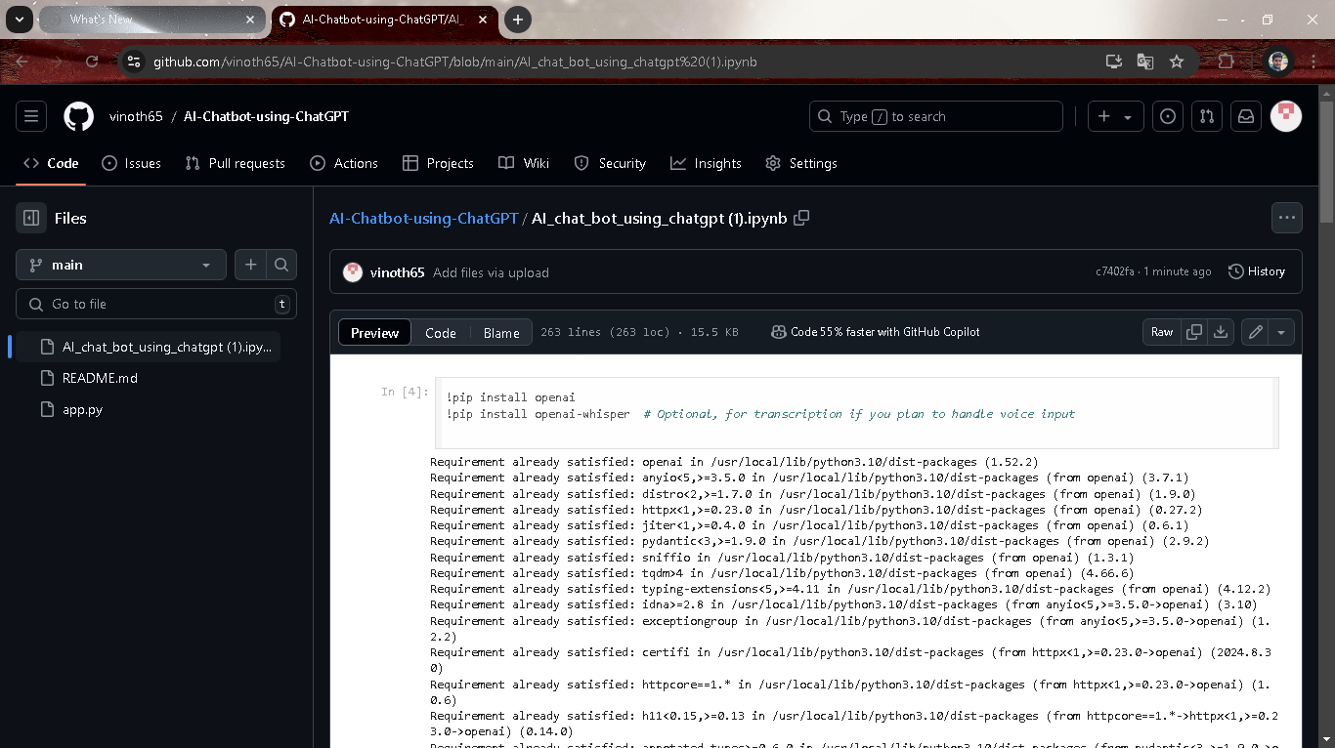

Slide 16
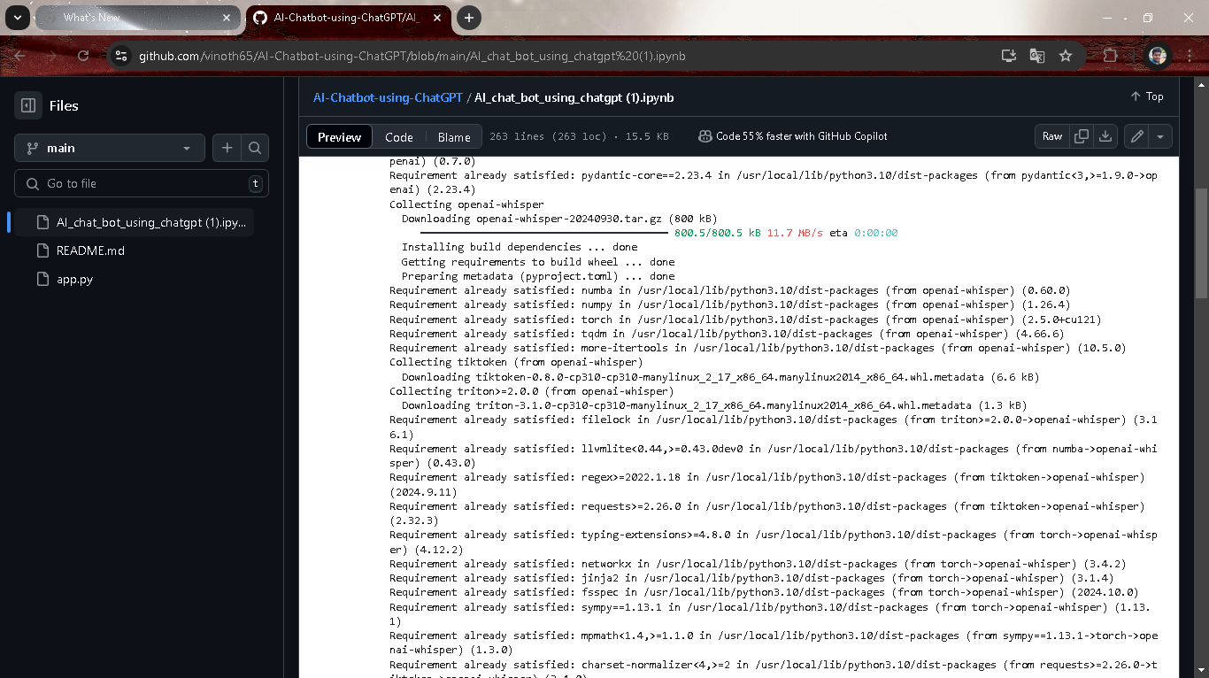

Slide 17
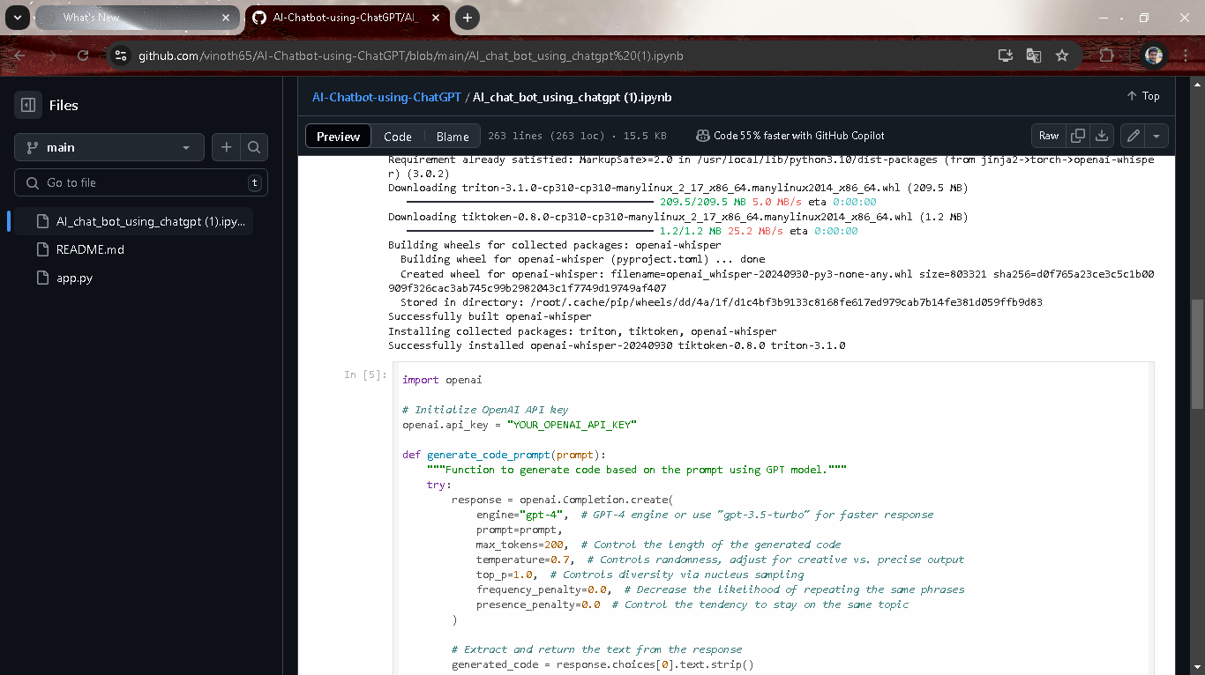

Slide 18
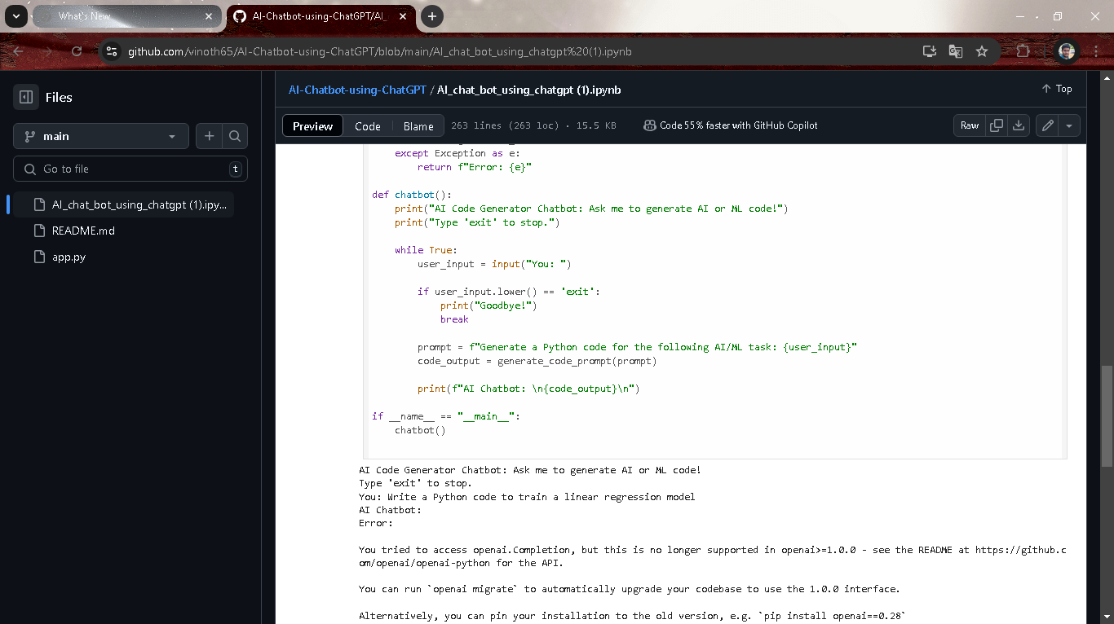

Slide 19
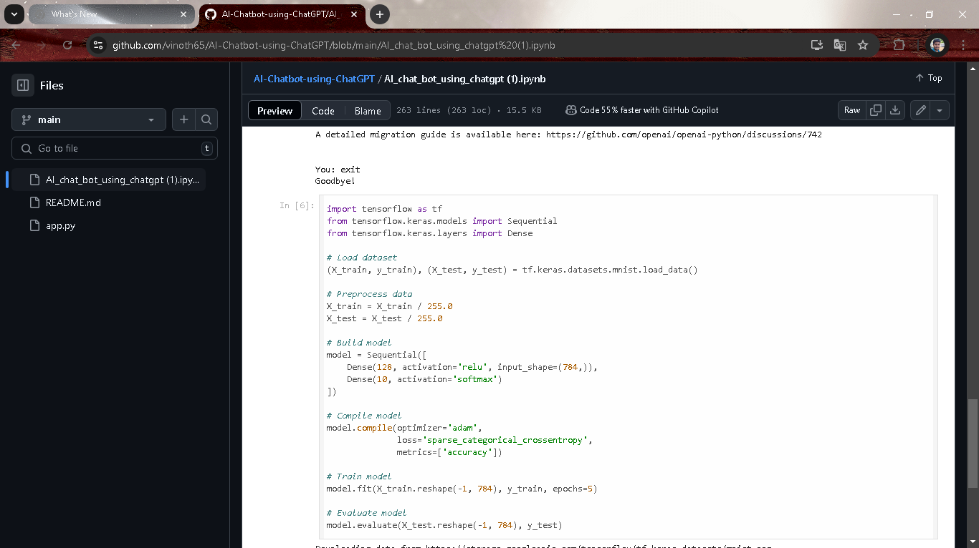

Slide 20
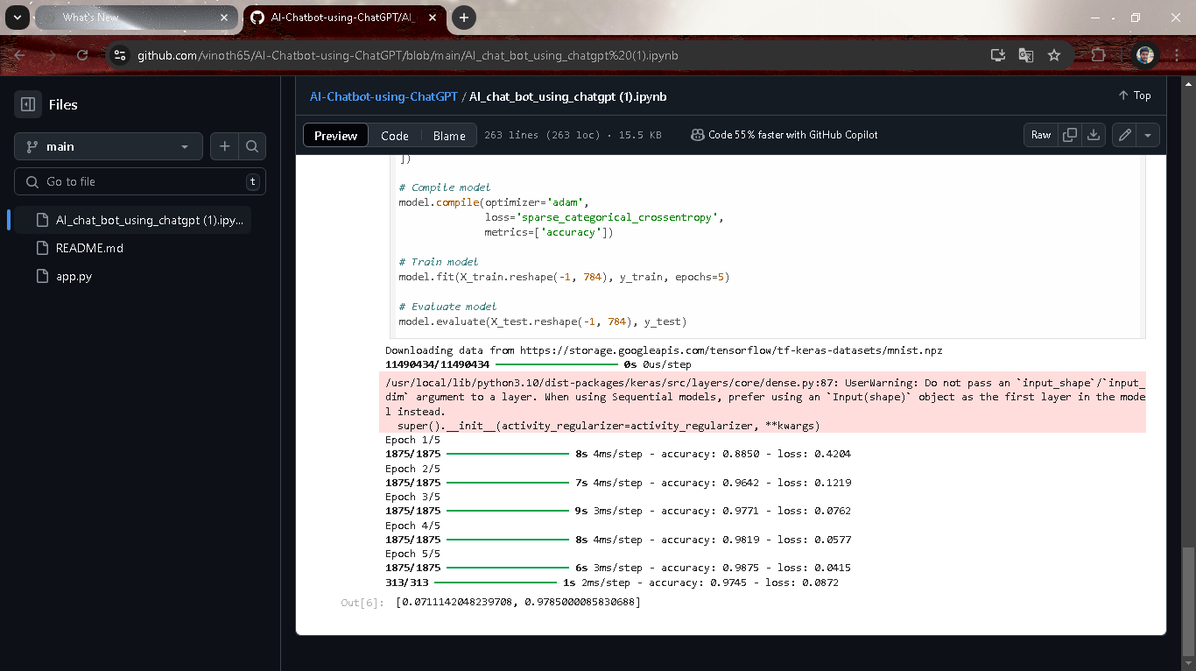

Slide 21
Discussion and Conclusion

Slide 22
Response Accuracy and Coherence: ChatGPT shows a remarkable ability to generate human-like responses in most scenarios. However, response accuracy can vary, particularly with ambiguous or highly specialized queries. Fine-tuning and reinforcement learning can enhance accuracy, but there is a balance to maintain between general language understanding and domain specificity.
Context Retention: Maintaining context across multiple turns is critical for a seamless conversational experience. ChatGPT’s transformer-based architecture supports short-term context retention well, yet it faces limitations in long-term memory, impacting performance in extended conversations. Solutions like dynamic context buffers or hybrid architectures with memory modules are promising avenues to address this limitation.
Safety and Ethical Considerations: ChatGPT’s application in conversational AI raises ethical questions related to response safety, bias, and handling of sensitive topics. Although safety filters and ethical guidelines are in place, no system is entirely free from potential biases embedded within its training data. Continuous monitoring, bias mitigation strategies, and ethical guidelines are essential to ensure responsible usage.

Slide 23
User Satisfaction and Personalization: User satisfaction is generally high, with positive feedback on the chatbot’s responsiveness and natural conversational style. However, personalization remains challenging due to privacy concerns and data limitations. Implementing dynamic, context-aware responses tailored to individual users without storing personal data is an ongoing research focus, especially in applications where privacy is paramount.
Scalability and Integration: ChatGPT-based chatbots have shown the ability to scale across multiple platforms, providing consistency in user experience. However, the technical requirements of integrating across devices, such as mobile and web, can introduce challenges in performance, particularly in latency-sensitive environments. Scalability is also essential to handle high user volumes, requiring optimized server configurations and load balancing mechanisms.

Slide 24
Git Hub Link of the Project: https://github.com/vinoth65/AI-Chatbot-using-ChatGPT.git

Slide 25
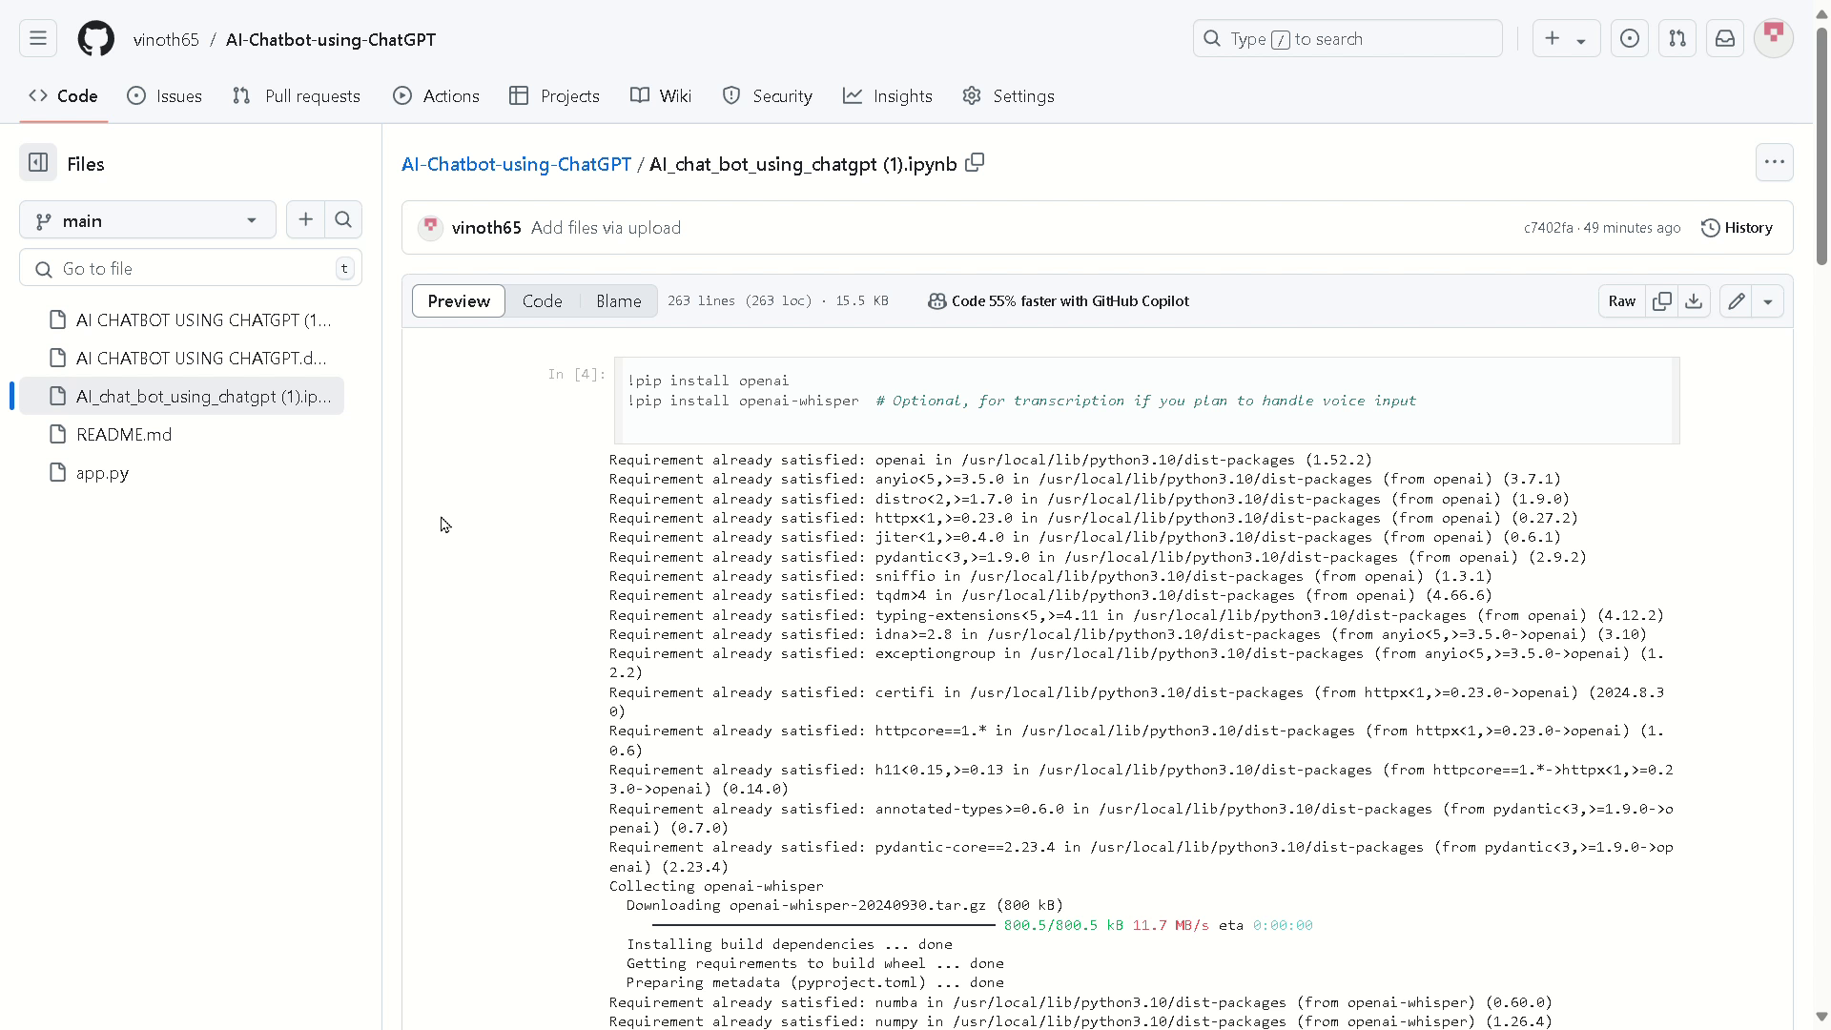

Slide 26
REFERENCES

Slide 27
· LIDDY, E. D
(2001). "Natural language processing." Encyclopedia of Library and Information Science, 71(1), 1-15.
• Discusses the historical development of natural language processing and its applications in chatbots, focusing on the transition from rule-based to AI-driven conversational agents.
· SHAWAR, B. A., & ATWELL, E
(2007). "Chatbots: Are they really useful?" LDV Forum, 22(1), 29-49.
•Analyzes early chatbot technology, providing a background on how chatbot applications and effectiveness have evolved over time.
· Brown, T., Mann, B., Ryder, N., Subbiah, M., Kaplan, J., Dhariwal, P., ... & Amodei, D. (2020). "Language models are few-shot learners." Advances in Neural Information Processing Systems, 33, 1877-1901.
•Introduces GPT-3, the foundation for ChatGPT, explaining how few-shot learning capabilities enable the model to perform well with minimal task-specific data.

Slide 28
OPENAI. (2023). "GPT-4 TECHNICAL REPORT.
" arXiv preprint arXiv:2303.08774.
•The official technical report for GPT-4, discussing model architecture, training, capabilities, and limitations, and providing insight into the latest advancements in language models.
· VASWANI, A., SHAZEER, N., PARMAR, N., USZKOREIT, J., JONES, L., GOMEZ, A. N., ... & POLOSUKHIN, I
. (2017). "Attention is all you need." Advances in Neural Information Processing Systems, 30, 5998-6008.
•Describes the transformer model architecture, which underpins the ChatGPT language model and has become a key technology in modern NLP..

Slide 29
Thanks you!

